Slide 1
American Recovery and Reinvestment Act (ARRA) Reporting Requirements
Office of Sponsored Programs
December 2009

Slide 2
Agenda
Basic Principles and Requirements
Principal Investigator Involvement in Reporting
Reporting Data Elements
Reporting Requirements and Issues
VCU Reporting Process
Reporting on Jobs Creation Estimates
FederalReporting.gov Timeline

Slide 3
Basic Principles and Requirements
What reporting is required under Section 1512?
Total amount of funds received; and of that, the amount spent on projects and activities;
A list of projects and activities funded by name to include:
    Description
    Project Completion status*
    Estimates on jobs created or retained;*
Details on sub-awards and other payments

Slide 4
PI Involvement in Reporting
OSP is working very closely with the Controller’s Office to minimize the impact of this reporting on Principal Investigators.
Of the 30 possible elements, only 4 are required of Principal Investigators.
Principal Investigators will report data elements to OSP. OSP will prepare and submit all reports to www.FederalReporting.gov

Slide 5
Reporting Data Elements
Principal Investigators need to report only the data elements listed in red. OSP and the Controller’s Office are collecting and reporting the data elements listed in blue.
Federal Funding Agency Name
Award identification
Recipient D-U-N-S
Parent D-U-N-S
Recipient CCR information
CFDA number, if applicable
Project description/Quarterly Activities
Status, to include sub-recipient project description and status

Slide 6
Reporting Data Elements cont’d
Prime Recipient Basic requirements
Job creation narrative, to include sub-recipient job-creation narrative
Job creation number, to include sub-recipient job creation
Infrastructure expenditures and rationale, if applicable
Recipient account number
Project/grant period
Award type, date, description, and amount
Amount of Federal Recovery Act funds expended to projects/activities
Activity code and description
Recipient primary place of performance
Recipient officer names and compensation (Top 5)
Total number and amount of small sub awards; less than $25,000

Slide 7
Reporting Data Elements cont’d
Sub-Recipient Basic requirements (also referred to as FFATA Data Elements)
Sub-recipient D-U-N-S
Sub-recipient CCR information
Sub-recipient type
Amount received by sub-recipient
Amount awarded to sub-recipient
Sub-award date
Sub-award period
Sub-recipient place of performance
Sub-recipient officer names and compensation (Top 5), if applicable

Slide 8
Reporting Data Elements cont’d
Recipient Vendor Basic requirements
D-U-N-S or Name and zip code of Headquarters (HQ)
Expenditure amount
Expenditure description
Sub-Recipient Vendor Basic requirements
D-U-N-S or Name and zip code of Headquarters (HQ)

Slide 9
Reporting Requirements
Reports are due on a calendar quarter basis (10 days after each calendar quarter).
Reports are due January 10, April 10, July 10, and October 10
Reporting is cumulative from date of your award
Reporting is in addition to regular progress reports, as required by your grant award
These reports cannot be combined with any other reports required

Slide 10
Additional Reporting Issues
No waivers or extensions of reporting requirements or deadlines
Non-compliance could be treated as a violation of the award agreement, resulting in termination of your award
Finally, most of the information submitted will ultimately be available to the public through www.Recovery.gov

Slide 11
VCU’s Reporting Process
One-time verification of Award Description
  E-mail verification
Calendar Quarterly updates of Status, Quarterly Activities, Jobs Numbers, and Jobs Narratives
  Quarterly Data Collection via Web Form

Slide 12
Award Description Verification
Following receipt of your award, OSP will send an e-mail that includes your Award Description (pulled from the Abstract or Narrative portion of your proposal). We will ask that you verify, via e-mail, that it is an appropriate Award Description for use in the quarterly reports. You may accept as presented or edit as you wish.

Slide 13
Quarterly Reporting Activities
OSP will send an e-mail message to each PI ARRA recipient on the 15th of the month prior to the report deadline, reminding them to submit their data. A link in the e-mail message will take them to the VCU ARRA Reporting Form.
The VCU ARRA Reporting Form should be completed and submitted by the PI by the 1st of the reporting month. Again, this form collects only the four (4) data elements required of the Principal Investigator.

Slide 14
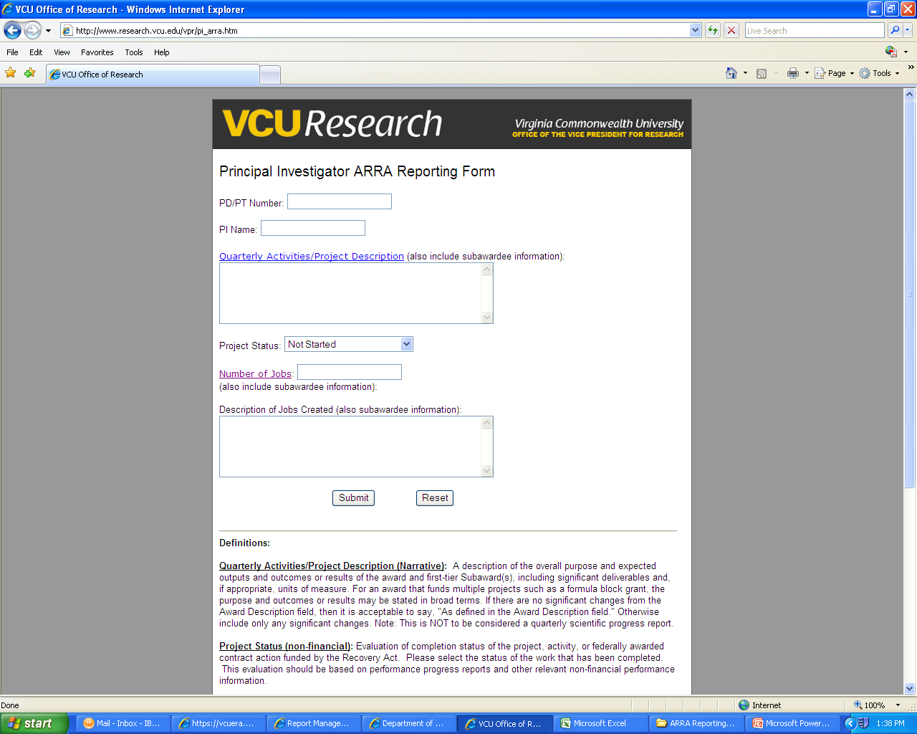
VCU ARRA Reporting Form
Definitions for each of the reporting categories are on the next page and are linked to the form itself.

Slide 15
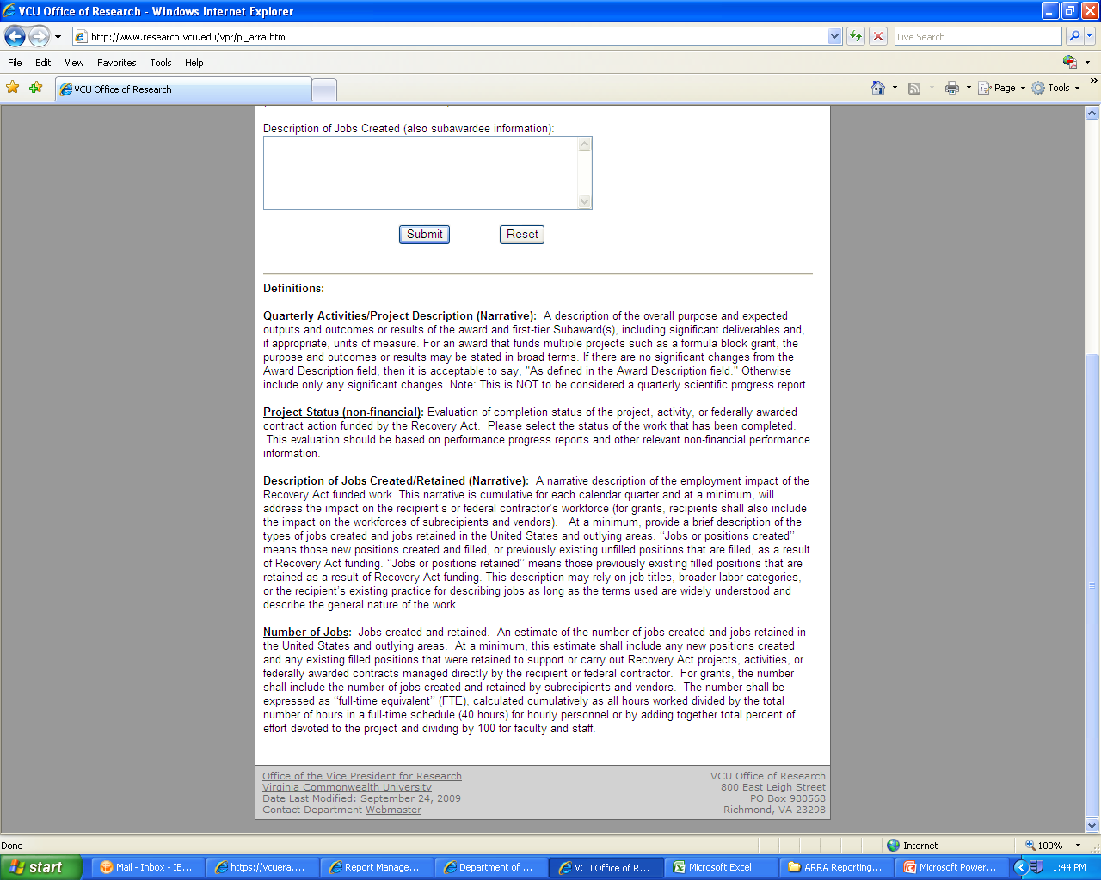
Definitions of Data Elements

Slide 16
Reporting on Jobs Creation
VCU is required to report on all jobs created or retained as a result of the ARRA funds, by project or activity.
  Job Created: a new position created and filled or an existing position that is unfilled but now being filled as a result of ARRA $$.
  Job Retained: a pre-existing position that would not have been filled without ARRA $$.
This information will be reported as two separate fields – a numeric field and a separate narrative with an expanded description of the job creation and reporting methodology.

Slide 17
Reporting on Jobs Creation
Principal Investigators must report the number of jobs created and retained using a standard calculation, translating both full and part time employees into “full-time equivalents”, or FTEs.
Principal Investigators and other tenure-track faculty are not to be included in these calculations.
VCU must add subrecipient data on this element to its data when reporting.

Slide 18
Calculating FTE – Full time faculty and staff
For full time faculty and staff, calculation of FTE using percent effort is acceptable. To calculate, add the percents of effort for each individual working on the project together, then divide by 100. Result is FTE.
Example: 2 technicians, 1 at 40% effort and 1 at 80% effort. To calculate FTE:
40% + 80% = 120 divided by 100 = 1.2 FTE

Slide 19
Calculating FTE – Hourly Employees
For hourly employees, FTE is calculated by adding the total hours worked by all hourly employees in an average week, and dividing by the total hours in a full-time schedule (40 hours).
Example: 2 student employees – one working 20 hours per week and the other working 10 hours per week:
20 + 10 = 30 ÷ 40 = 0.75 FTE

Slide 20
FederalReporting.gov Timeline
REGISTRATION
OSP has registered at www.FederalReporting.gov
DATA COLLECTION
Begins the 15th of the month prior to each reporting month*
REPORT SUBMISSION
Days 1-10 of the reporting month – OSP completes this step
REVIEW (Comment Period)
Days 11-21of the reporting month – OSP will review submitted data to verify accuracy
Days 22-29 of the reporting month – Agency can review uploaded data and mark as: Not Reviewed; Reviewed – No Comments; Reviewed – Comments Provided
RELEASE
Day 30 – Final Public Reports available at Recovery.gov
Reporting Months are: January, April, July, and October

Slide 21
Contact Information
Jason Withers – ARRA Reporting Manager
jwithers@vcu.edu
Susan Robb – Assistant Vice President for Research Administration
sarobb@vcu.edu
Both can be reached at 828-6772.

